Slide 1
Logistic Regression

Slide 2
Introduction
Logistic Regression is classification algorithms for predicting Discrete or Categorical target field.
Application:
Predicting Employee Churn
Predicting chance of mortality in injured patients
Predicting whether a tumour is Benign or Malignant (Cancerous or Non-Cancerous)
Predicting probability of a person having a heart attack
Analogous to Linear Regression, but tries to predict the Categorical or Discrete target field.

Slide 3
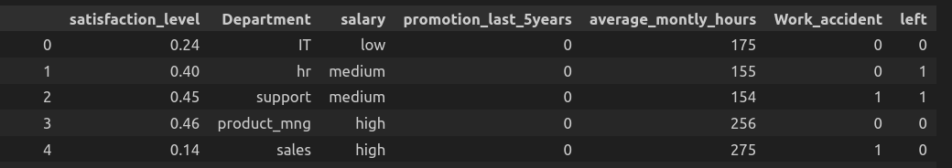
Example (Employee Churn Prediction)
Predicting whether Employee leaves company or not can be accomplished using Logistic Regression algorithms.
Independent Variables: satisfaction_level, Department, salary, etc
Dependent (Target) Variables: left
Independent Variables should be continuous, if categorical they should be converted to continuous value using techniques such as Label Encoder or Dummy variables.

Slide 4
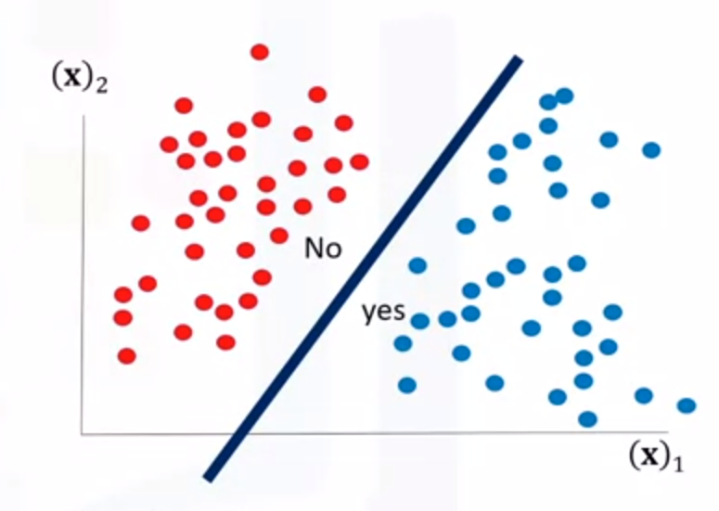
When to use Logistic Regression?
If your data is binary
0 / 1, Yes / No, True / False
If you need probabilistic result.
y_hat = P(y=1 | x) → probability of output
Belonging to class 1
given features
P(y=0 | x) = 1 - P(y=1 | x)
If your data is linearly separable. As Decision
boundary of logistic regression is line or
plane or hyperplane.
Source: IBM Data Science

Slide 5
Logistic Regression vs Linear Regression
If your data is binary

Slide 6
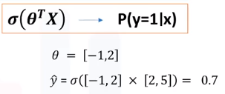


Logistic Regression Training Process
Initialize θ → via random numbers
Calculate =
ŷ = predicted probability of class 1
σ = Sigmoid / Logistic function
Θ = model parameters
X = independent variables
Compare the output of ŷ with actual output y, and record it as error.
Loss = Binary Crossentropy =
Calculate the error for all customers.
Cost(ŷ, y) = J(θ)

Slide 7
Logistic Regression Training Process
Update parameters θ to reduce cost function (Lower cost means accurate prediction)
Cost(ŷ, y) = J(θ)
Θ → θ(new) → J(θ(new))
Go back to step 2 (until stop iteration)
“There are several strategy to reduce cost of Logistic Regression, One of the popular strategy is Gradient Descent”

Slide 8
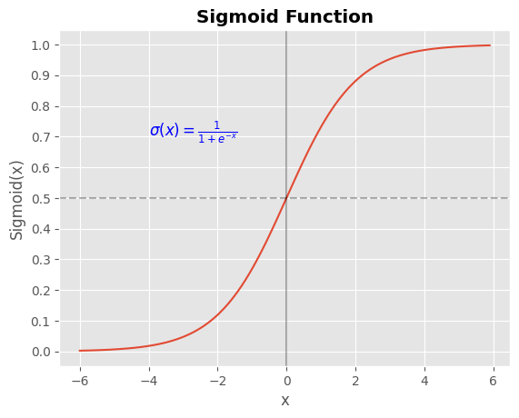
Sigmoid Function
Squeezes data in range [0, 1]
If x → -infinite
Sigmoid(x) → 0
If x → +infinite
Sigmoid(x) → 1

Slide 9
Sigmoid Function (Lab)
import numpy as np
import matplotlib.pyplot as plt
# define sigmoid formulae
formula_text = r'$\sigma(x) = \frac{1}{1 + e^{-x}}$'
# define x_data range
x_data = np.arange(-6, 6, 0.1)
func = 1/(1+np.exp(-x_data))
plt.plot(x_data, func, label='Sigmoid Function')
plt.axvline(x=0, color='black', label='x = 0', alpha=0.3)
plt.axhline(y=0.5, color='black', linestyle='--', alpha=0.3)
plt.annotate(formula_text, xy=(-4, 0.7), fontsize=12, color='blue')
plt.yticks(np.arange(0, 1.1, 0.1))
plt.grid(True)
plt.xlabel('x')
plt.ylabel('Sigmoid(x)')
plt.title('Sigmoid Function', fontweight='bold')
plt.show()

Slide 10
Cost Function
Cost function is the average of error or loss considering all data points.
Key concept: Update the model parameters via minimizing the Cost Function
Logistic Objective Function (Cost Function): Binary Cross-Entropy Function
Formulae of Cost function denoted by J(θ) is given by,
y_hat is model prediction
y is actual target
If y = 1 and y_hat = 1 → J(θ) = 0 (Low cost)
If y = 1 and y_hat = 0 → J(θ) = large value (High Cost)

Slide 11
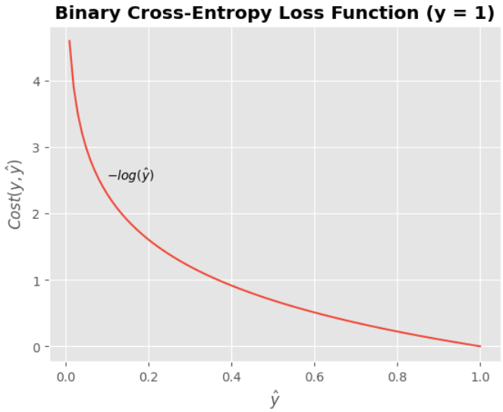
Cost Function (Lab1)
import numpy as np
import matplotlib.pyplot as plt
# Define a range of predicted probabilities
# (e.g., between 0 and 1)
predicted_probs = np.linspace(0, 1, 100)
# assume all true labels are 1
true_labels = 1
# Calculate the binary cross-entropy loss for each
# predicted probability
loss = - (true_labels * np.log(predicted_probs))
plt.annotate("$-log(\hat{y})$", xy=(0.1, 2.5))
# Plot the loss function
plt.plot(predicted_probs, loss)
plt.xlabel('$\hat{y}$')
plt.ylabel('$Cost(y, \hat{y})$')
plt.title('Binary Cross-Entropy Loss Function (y = 1)',
fontweight='bold')
plt.grid(True)
plt.show()

Slide 12
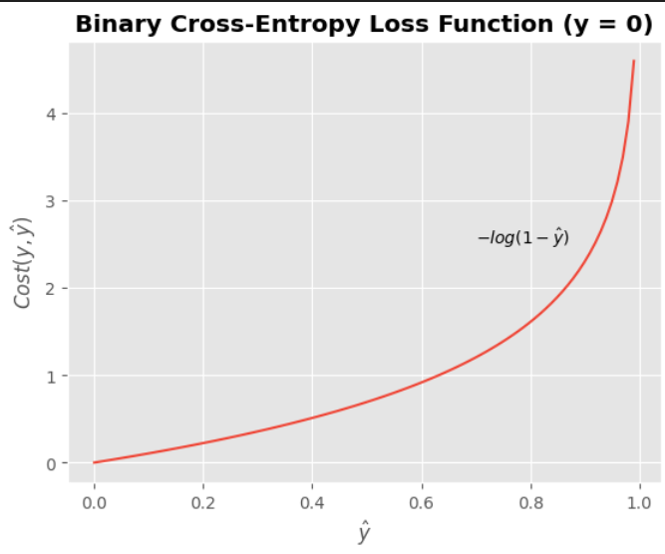
Cost Function (Lab2)
import numpy as np
import matplotlib.pyplot as plt
# Define a range of predicted probabilities
# (e.g., between 0 and 1)
predicted_probs = np.linspace(0, 1, 100)
# Define true labels = 0
true_labels = 0
# Calculate the binary cross-entropy loss for
# each predicted probability
loss = -(1 - true_labels) * np.log(1 - predicted_probs)
# Plot the loss function
plt.plot(predicted_probs, loss)
plt.annotate("$-log(1-\hat{y})$", xy=(0.7, 2.5))
plt.xlabel('$\hat{y}$')
plt.ylabel('$Cost(y, \hat{y})$')
plt.title('Binary Cross-Entropy Loss Function (y = 0)',
fontweight='bold')
plt.grid(True)
plt.show()

Slide 13
Questions
How to find best parameters of our model?
Minimize the cost function
How to minimize the cost function?
Several optimizations approaches available,
We will use Gradient Descent

Slide 14
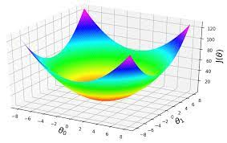
Gradient Descent
It is the iterative approach in finding the minimum of a function (cost function).
It is the technique to use the derivative of a cost function to change the parameter values, in order to minimize the cost.
IDEA:
Start at random point
Move Downhill step by step to
reach surface
Each step size is controlled
By factor called the
“learning rate”
machinelearningspace

Slide 15
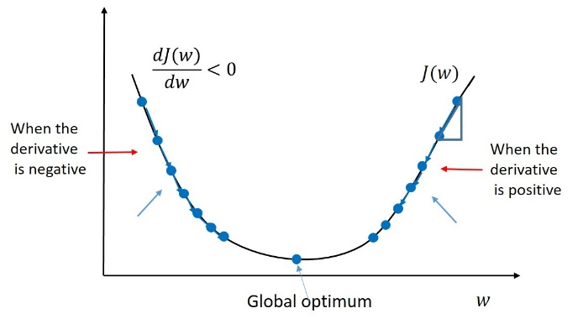
Gradient Descent
Algorithms
Initialize model parameters (e.g. w) randomly.
Calculate the gradient of the objective function with respect to the parameters.
Update the parameters using the gradient and the learning rate.
Repeat steps b and c until convergence.
Source: Master Data Science

Slide 16
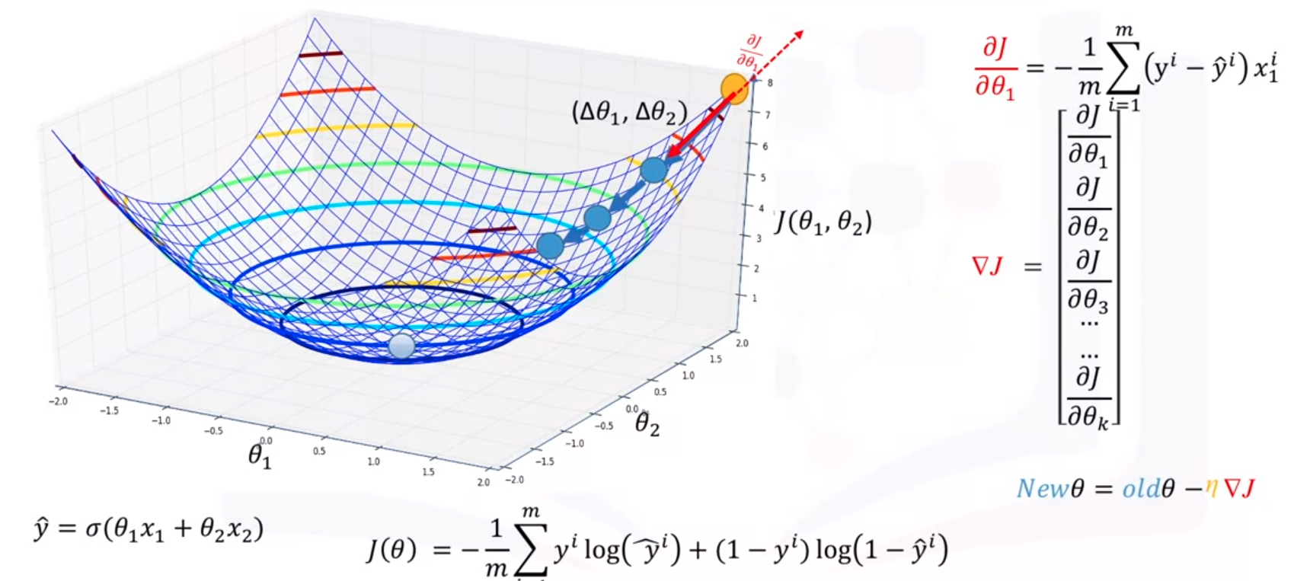
Gradient Descent (2 parameters)
Credit: IBM Machine Learning

